Slide 1
Efficient Retrieval over Documents Encrypted by Attributes in Cloud Computing
Name:
Roll Number:

Slide 2
INTRODUCTION
Secure document storage and retrieval is one of the hottest research directions in cloud computing.
a hierarchical attribute-based encryption scheme is first designed for a document collection. A set of documents can be encrypted together if they share an integrated access structure.
Compared with the ciphertext-policy attribute-based encryption (CP-ABE) schemes, both the ciphertext storage space and time costs of encryption/decryption are saved. Then, an index structure named attribute-based retrieval features (ARF) tree is constructed for the document collection based on the TF-IDF model and the documents’ attributes.
A depth-first search algorithm for the ARF tree is designed to improve the search efficiency which can be further improved by parallel computing

Slide 3
EXISISTING SYSTEM
First, most existing schemes focus on encrypting a single access tree. However, it is impossible that all the documents in share a single access tree and how to construct a set of optimized access trees for the document collection is a huge challenge
Second ,in most existing schemes, when the documents are mapped to a set of shared access trees, the data users need to store a large number of secret keys which will be analyzed in Hierarchical Document Encryption
Except for access control, document search efficiency is also a challenge for a large document collection

Slide 4
DISADVANTAGES OF EXISISTING SYSTEM
However, all these schemes cannot support effective, flexible and efficient document search because of their simple functionalities.
The sensitive information, such as personal information, company financial data and government documents, to the public is a big threat to the data owners. In addition, to make full use of the data on the cloud, the data users need to access them flexibly and efficiently is not possible

Slide 5
PROPOSED SYSTEM
To support the previously discussed service, we first design an algorithm to generate hierarchical access trees for the document collection. The proposed algorithm employs the greedy strategy to build the access trees incrementally and each access tree grows by continuously splitting the nodes In the tree.
Then we design a ciphertext-policy attribute-based hierarchical document collection encryption scheme called CP-ABHE. In the proposed scheme, a set of documents can share a same integrated access tree and be encrypted together rather than being encrypted individually.
. We first map the documents to document vectors based on the TF-IDF model and, in addition, the attributes of the documents are also taken into consideration. The similarity function between the document vectors is carefully designed and the vectors are organized based on their relative similarities in the attribute-based retrieval features (ARF) tree

Slide 6
ADVANTAGES OF PROPOSED SYSTEM
An advantage of the scheme is that the data users can decrypt all the authorized documents by computing the secret key once.
To make the data users able to access part of on demands, a possible approach is encrypting the documents through attribute-based encryption(ABE) schemes ,before outsourcing them to the cloud.
In these scheme can upload the multiples file by encrypting and we can download the multiple files at a time

Slide 7
SYSTEM REQUIREMENTS
HARDWARE REQUIREMENTS
System : Pentium Dual Core.
Hard Disk : 120 GB.
Monitor : 15’’ LED
Input Devices : Keyboard, Mouse
Ram : 1GB.

Slide 8
SYSTEM REQUIREMENTS
SOFTWARE REQUIREMENTS
Operating system : Windows 7.
Coding Language : JAVA/J2EE
Tool : Net beans 7.2.1
Database : MYSQL

Slide 9
MODULES
Data Owner
Encrypted Document Collection
Cloud Server
Attribute-based Retrieval Feature and ARF Tree

Slide 10
Data Owner:-
The data owner is responsible for collecting and preprocessing the documents, and then obtains a set of high quality files F.
He sets the attributes for each document and then hierarchically encrypts the document collection based on attributes. In addition, an index vector is extracted from each document based on the document’s content and attributes.
An index structure I is constructed based on the index vectors of the documents. At last, both the encrypted documents C and encrypted index structure are sent to the cloud server. The cloud server is responsible for storing the encrypted documents and executing document search based on the index structure.

Slide 11
Encrypted Document Collection
The efficient retrieval scheme over encrypted document collection is designed and we first describe the process of constructing the ARF tree
Then a depth-first searching algorithm of the ARF tree is designed and in addition, it can be operated in a parallel manner flexibly. Given a collection of documents F = {F1; F2; · · · ; FN}, each document needs to be scanned for one time and the number of each keyword is recorded.
Then a normalized vector for the document is generated based on the keyword dictionary. The attribute vector of a document can be built based on attribute dictionary A and the associated attributes assigned by the data owner.

Slide 12
Cloud Server
The Cloud Server and CA center are assumed to be trustable. we focus on the security of the proposed hierarchical document encryption scheme and its security mainly involves two aspects including document confidentiality and content keys confidentiality.
The documents are encrypted based on symmetric encryption schemes (e.g., AES) with content keys and their security is out of the scope in this project.

Slide 13
Attribute-based Retrieval Feature and ARF Tree
To improve the search efficiency of multi-keywords search process, a height- balanced index tree named ARF tree is built based on the document vectors.
Specifically, the document vectors are organized as clusters according to their similarities.
Each node in the tree represents a cluster composed of a set of document vectors or sub-clusters.

Slide 14
UML DIAGRAMS

Slide 15
SYSTEM ARCHITECTURE:

Slide 16
DATA FLOW DIAGRAM:

Slide 17
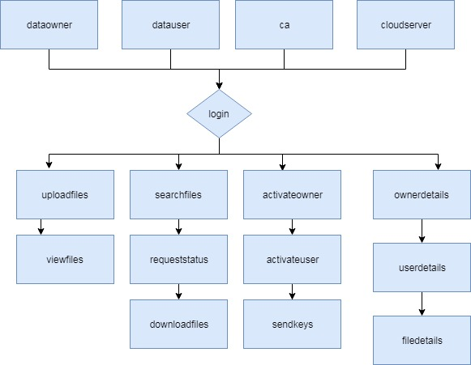

Slide 18
USE CASE DIAGRAM

Slide 19
CLASS DIAGRAM

Slide 20
SEQUENCE DIAGRAM

Slide 21
ACTIVITY DIAGRAM

Slide 22
OUTPUT SCREENS

Slide 23
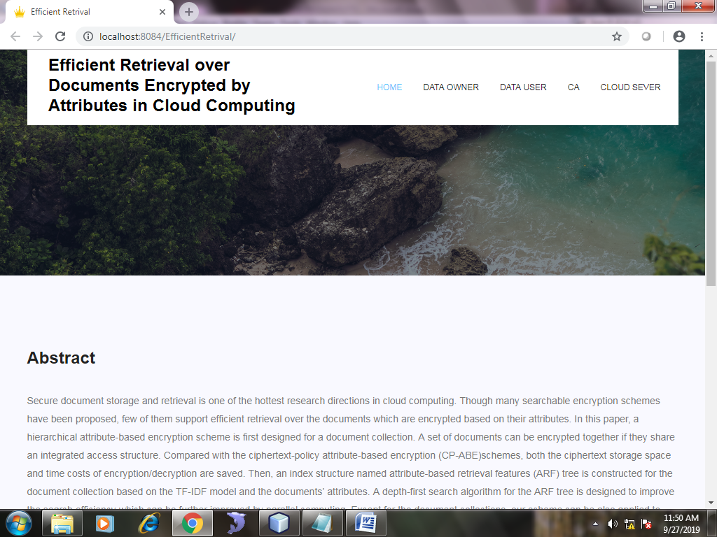
Home Page:

Slide 24
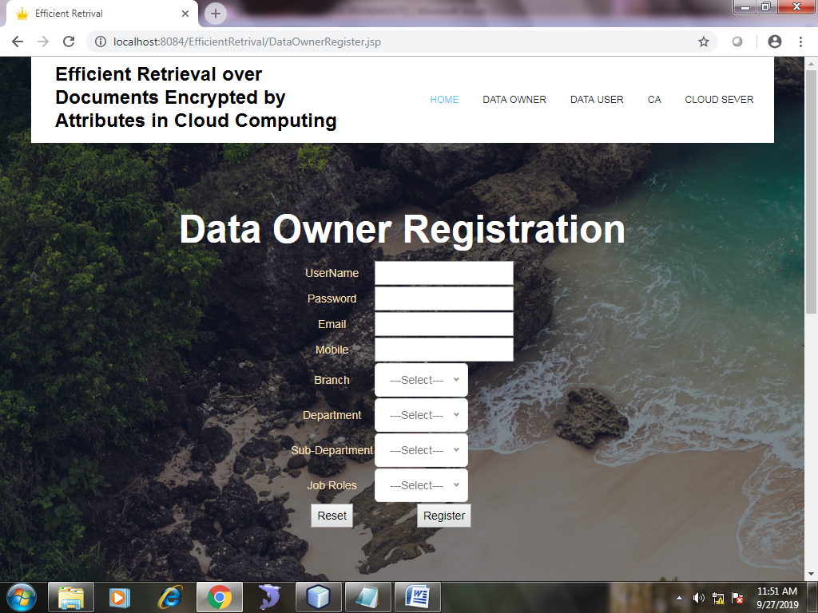
Dataowner Register

Slide 25
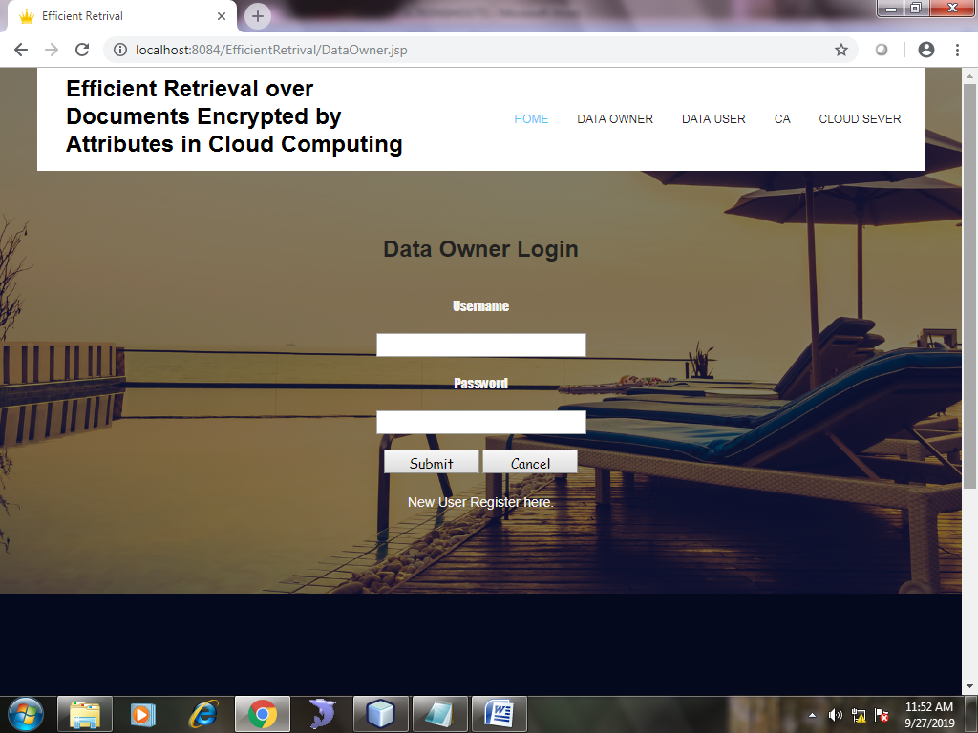
DataOwner login page:

Slide 26
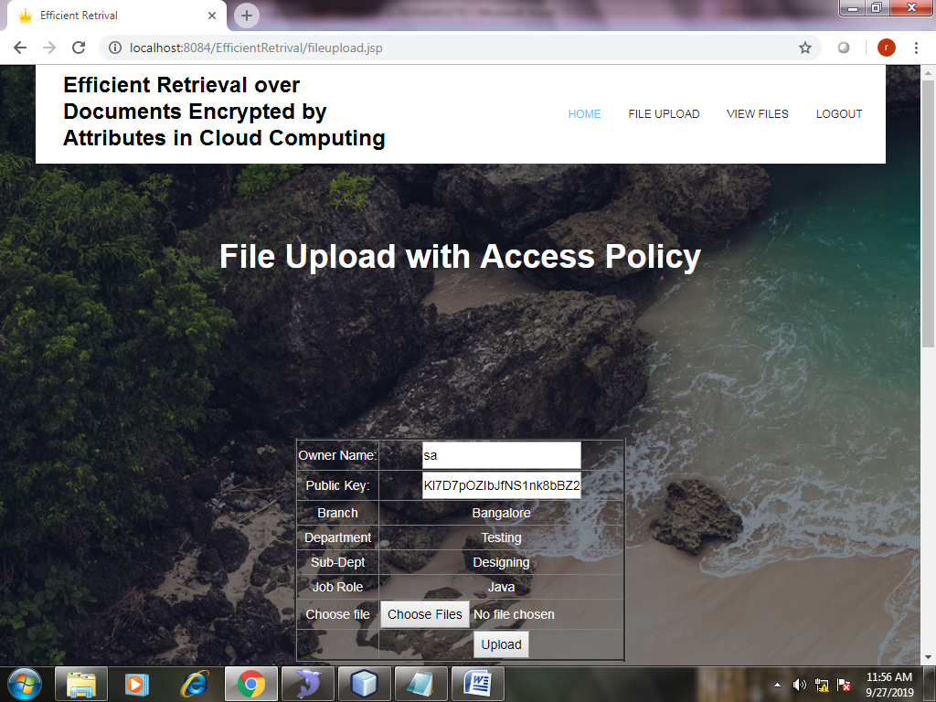
Dataowner File Upload

Slide 27
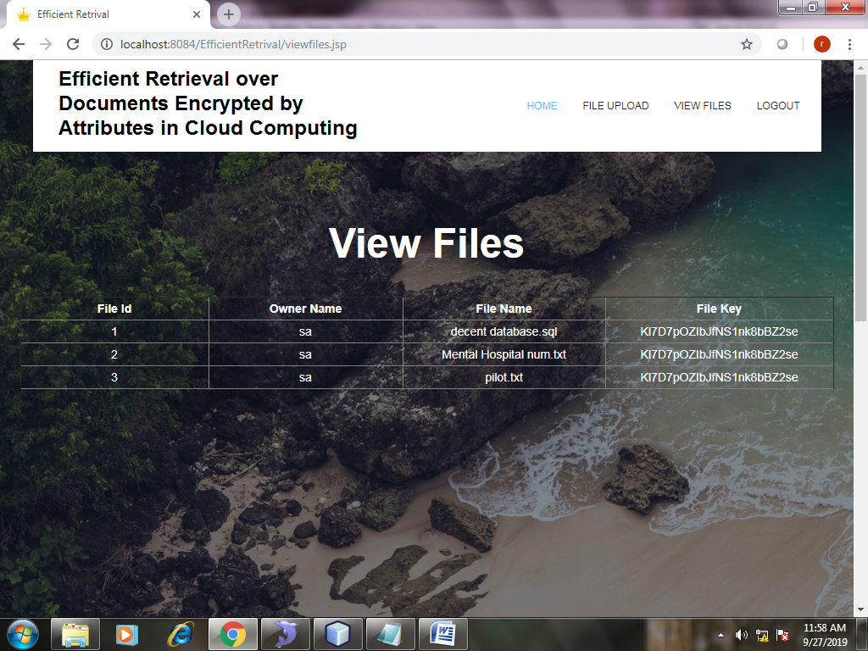
View Files

Slide 28
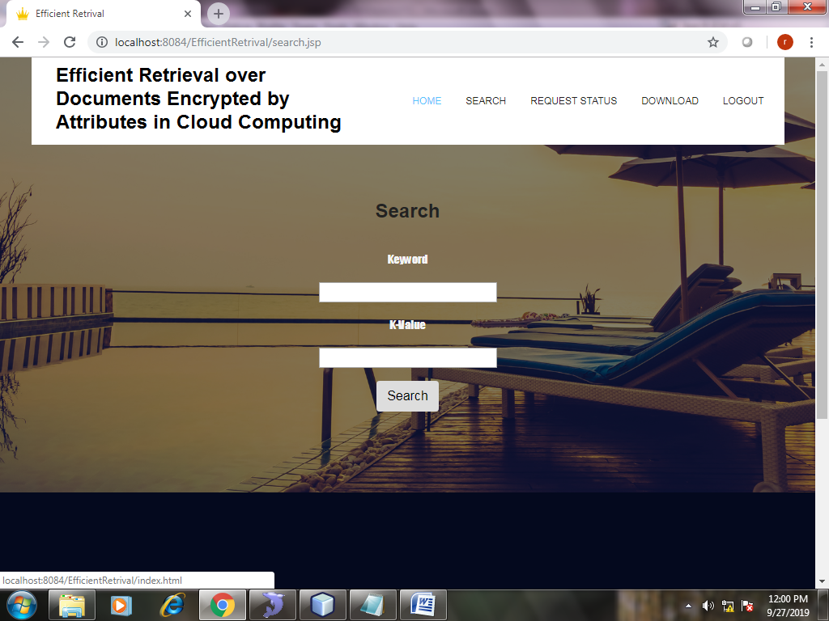
Search Files

Slide 29
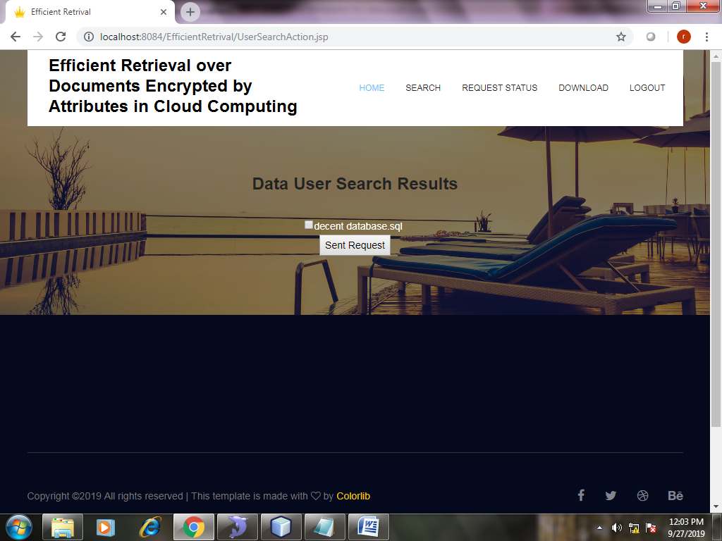
Search Results

Slide 30
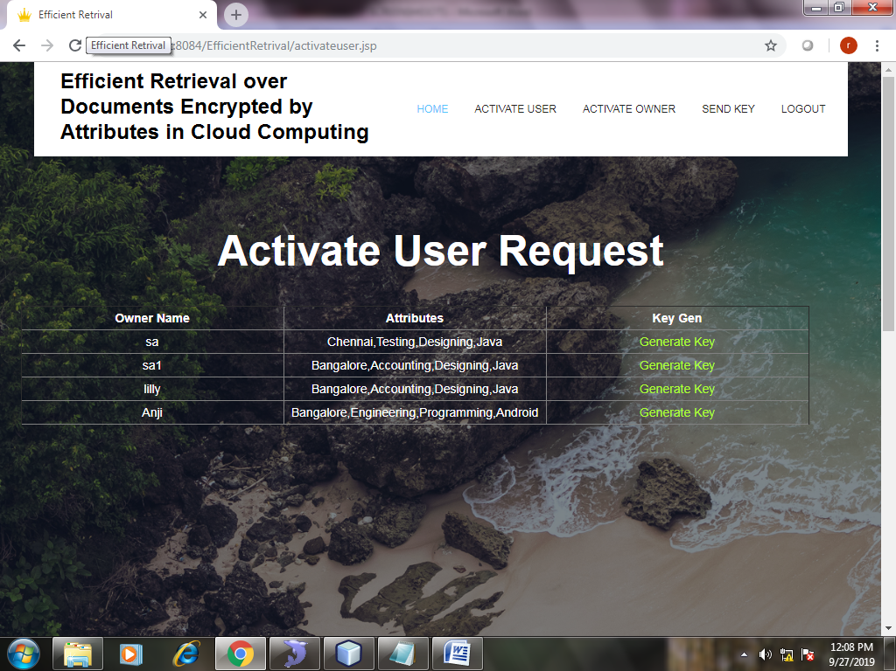
Activate User Request

Slide 31
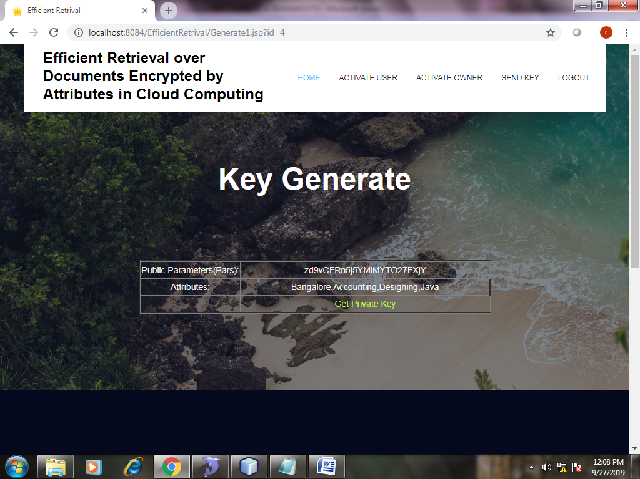
Key Generations

Slide 32

Cloud View Files

Slide 33

Activate Owners

Slide 34
CONCLUSION
Further, the ARF tree is proposed to organize the document vectors based on their similarities. At last, a depth-first search algorithm is designed to improve the search efficiency for the data users which is extremely important for large document collections. The performance of the approach is thoroughly evaluated by both theoretical analysis and experiments .
In this Project, we assume that each node in the access trees represent an “AND” gate and this limits the flexibility of assigning the attributes to the documents. In the future, we will attempt to introduce “OR” gates into the access trees. Second, the access structure of the document collection is generated in a greedy manner and we will check whether it can be further optimized to decrease the number of access trees

